Slide 1
Statistics 102
Monday July 3, 2017
I. Sensitivity, Specificity, Likelihood ratios, ROCs and AUCs
II. Type 1 and 2 errors and estimating the sample size needed for a study
III. Which test for statistical significance?
IV. Odds ratios and relative risk ratios
V. Non-inferiority (NI) trials

Slide 2
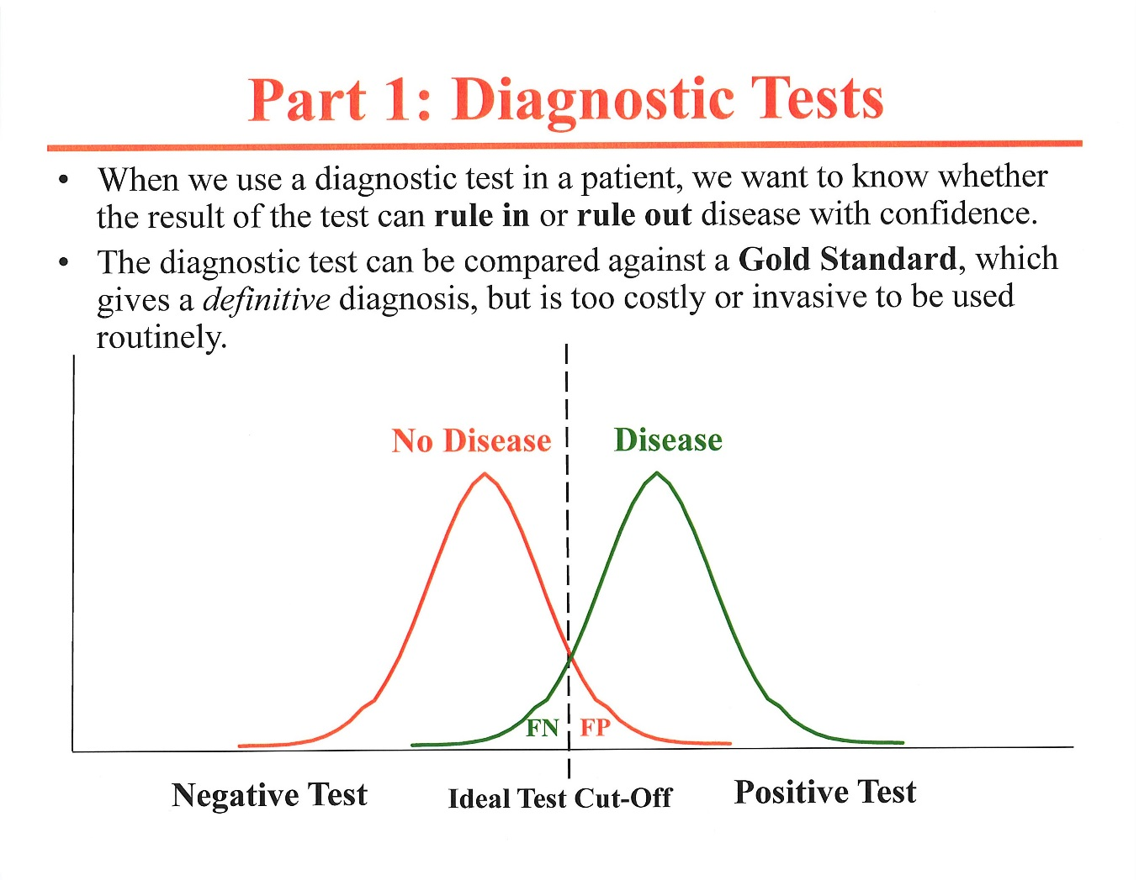
I. Sensitivity and Specificity of Diagnostic Tests
N

Slide 3
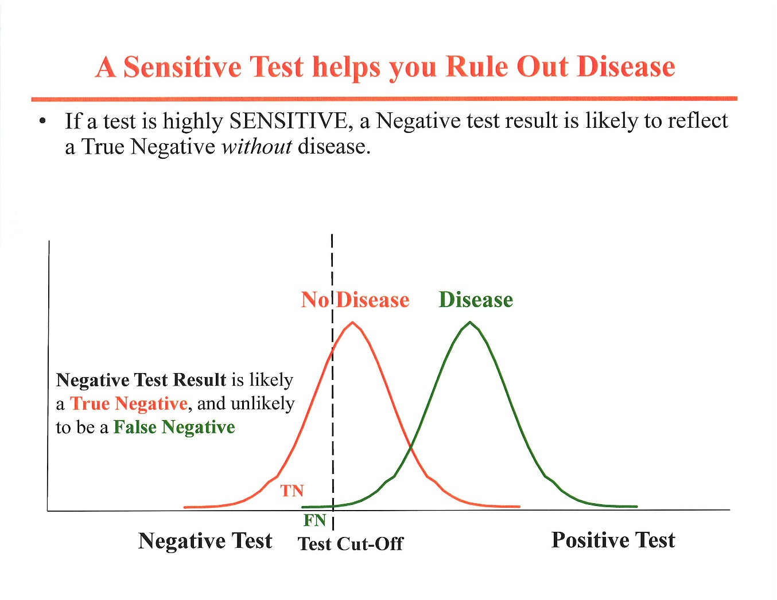
(e.g., ANA titer in SLE)

Slide 4
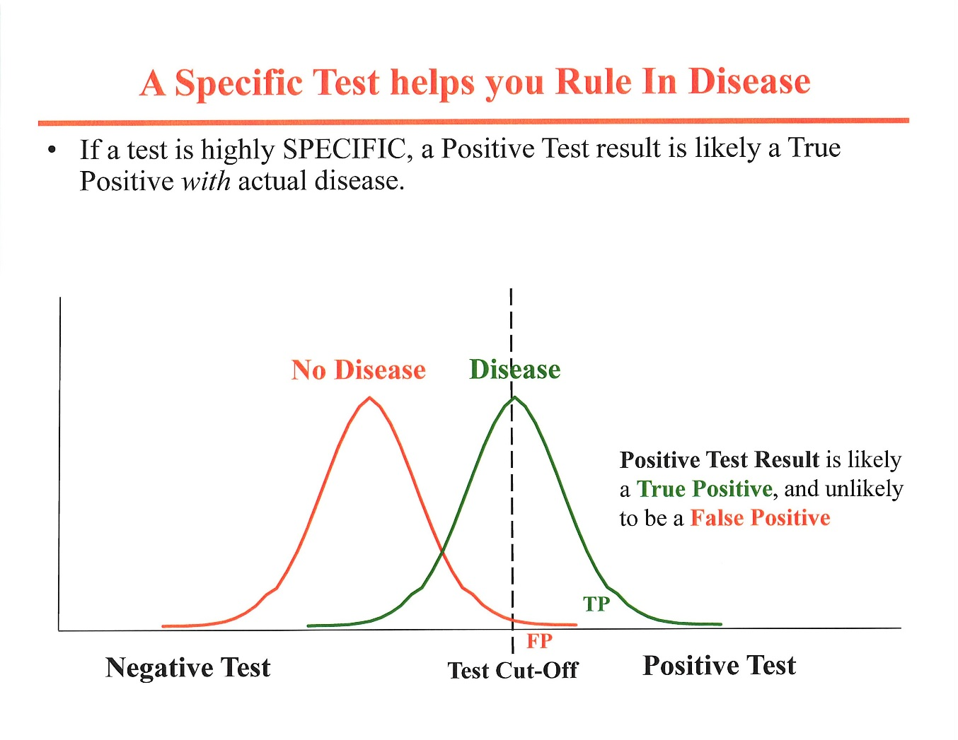
(e.g., dsDNA antibody titer in SLE)

Slide 5
Likelihood ratios
True positives + false positives = 1
True negatives + false negatives = 1
Sensitivity= true positives. 1-Sensitivity = false negatives
Specificity= 1 - false positives with a test. Rearranging:
False positives=1–Specificity (i.e., a highly specific test has few false positives)
Positive likelihood ratio = Sensitivity/(1-Specificity)=True positives/ False positives
  Many more True than False positives ⇒ very high positive likelihood ratio
Negative likelihood ratio = (1- Sensitivity)/Specificity=False negatives /True negatives
  Many more True than false negatives ⇒ very low negative likelihood ratio

Slide 6
Likelihood ratio: Example with PSA screening
Assume that a 70 y.o. man coming to your office has a pretest chance of prostate cancer of 1% (1 in 100).
Also assume the serum PSA level (using a test cutoff of 4 ng/ml) is 80% sensitive and 90% specific.
What are the + and – Likelihood ratios (LRs)?
LR+ = true pos/false pos= .8/.1 = 8
  8 x 1% = 8% CHANCE of prostate cancer, or 1 in 12.5 or 2 in 25.
LR- = false neg/true neg= .2/.9 ≈ .22
  .22 x 1% = .22% CHANCE of prostate cancer, or 1 in 454

Slide 7
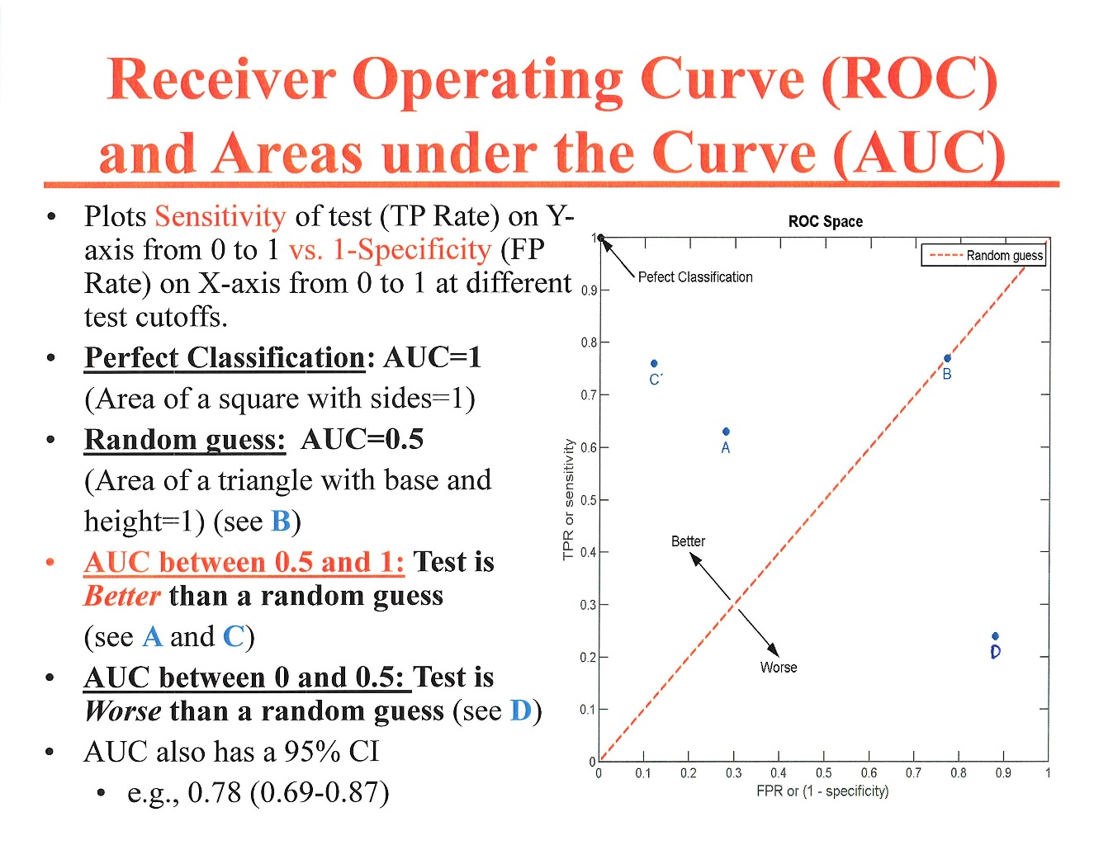
TPR=FPR

Slide 8
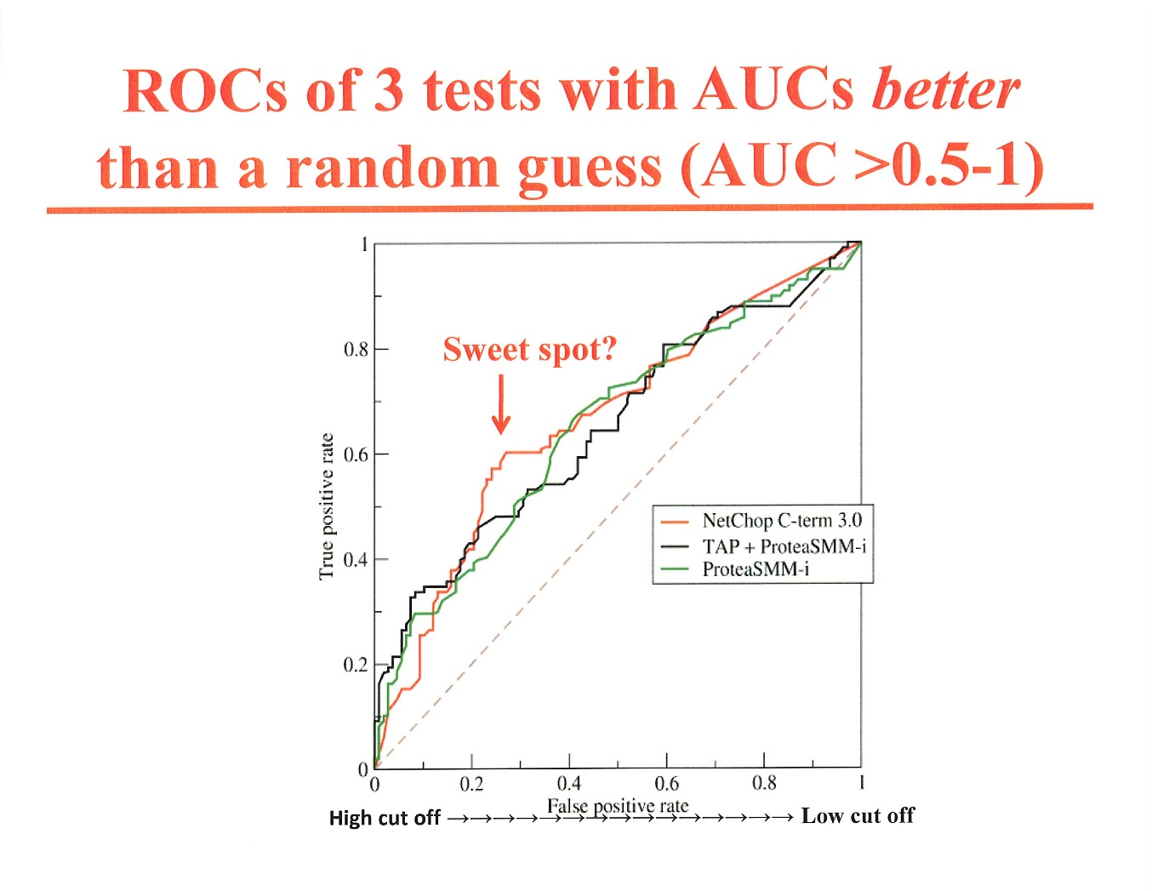
Can also calculate 95%
CI of AUC and compare
it with other AUCs
less sensitive
less specific

Slide 9
II. Type 1 and 2 Errors
Null Hypothesis: no difference between treatments or populations
Alternate hypothesis: treatments or populations differ
Reject null hypothesis in favor of alternative hypothesis
Accept null hypothesis
Correct decision
(no error)
Error
Correct decision
(no error)
Error
Type 1 (α)
Type 2 (β)

Slide 10
Choosing α (type 1 error) and β (type 2 error)
α (or p) is conventionally set at 0.05 (5%), the chance of a type 1 error if null hypothesis is rejected (≤ 5%)
Can state “p<0.05” or give exact p value (e.g., p=0.02)
β is often set at 2-4 times α , 0.10 (10%) or 0.20 (20%), the chance of a type 2 error if the null hypothesis is accepted
Power = 1- β, often 0.90 or 0.80 (90% or 80%). Power is the probability of rejecting the null hypothesis when the alternate hypothesis is true.
  tiny β ⇒ highly powered large β ⇒ inadequately powered

Slide 11
Sample size estimation using α and β in study planning
A new drug is developed for maintaining remission in ulcerative colitis. How many patients would be needed to be enrolled to be able to show that this new regimen is superior to the standard regimen using mesalamine?
Key questions to answer when planning study size:
1. What is the expected remission rate (proportion) for mesalamine? [p₁]
2. What would be a clinically significant, and reasonably predictable, improvement with the new drug? [p₂]
3. What should be the α (type 1) and the β (type 2) error of the study?

Slide 12
Sample size estimation, cont’d
p1 = 0.60 (5-ASA)
p2 = 0.80 (New Rx)
α = 0.05 (1 in 20)
β = 0.20 (1 in 5)
power = 0.80 (4 in 5)
From Fleiss Table A.3, N₁=N₂ = 100 and N₁+N₂=200.
If α=0.02 and β=0.10 (power=0.9), then N₁=N₂=154 and N₁+N₂=308

Slide 13
III. Which test for statistical significance?
DIFFERENCES
CORRELATIONS
Data normally distributed?
Pearson’s test
Data not normally distributed?
Spearman’s rank test
Data normally distributed? [less common]
  Paired t (each subject is his/her own control)
  Unpaired t (group t) using mean, SD, and n
  Analysis of variance (for > 2 groups)
Data not normally distributed? [more common]
Continuous variable?
  Wilcoxon’s sign rank test
  Mann Whitney U test
  Categorical variable?
  Fisher’s exact test using 2X2 table (Statistics 101)
  Chi Square test using 2X2 table (Statistics 101)

Slide 14
Student’s t test for a continuous variable
(William Sealy Gossett, who used the pseudonym Student)
A t test compares the means of two groups. For example, it compares whether systolic blood pressure differs between a control and treated group, between men and women, or any other two groups, including one group under two conditions (paired t test).
Don't confuse t tests with ANOVA. The t tests compare exactly two groups. ANOVA compares three or more groups.
Assumes parametric (non-skewed) data distribution (normal, bell-shaped Gaussian curve).

Slide 15
Wilcoxon’s sign rank test for a continuous variable
A nonparametric substitute for the paired t test when data are not normally distributed.
A good example would be the blood sugar level of a group of patients before a particular drug is applied, and the blood sugar level of the same group of patients just after the treatment. The result of Patient 1 before the treatment is matched with the result of Patient 1 after the treatment, and so on.
As is common with hypothesis testing in general, we start out with a Null Hypothesis, which can be thought of as our default assumption. The Null Hypothesis for the Wilcoxon Signed Rank test is that the two groups of data are not different. Based on the W statistic, which is calculated from the data, we determine whether to accept or reject the Null Hypothesis

Slide 16
Mann Whitney U test
A non-parametric substitute for the unpaired Student t test when the data are not normally distributed.

Slide 17
Correlations: Pearson’s test
The Pearson Product Moment Correlation is a parametric test for the linear relationship between two datasets. A note of caution - if there is a strong linear relationship between the two datasets (i.e. the absolute value of the correlation is close to unity), it does not imply that there is necessarily a causal relationship between the datasets. It could be that there is some underlying (as yet unknown) factor that is responsible for the strong correlation between the datasets.
Excel can easily calculate this from a spreadsheet.

Slide 18
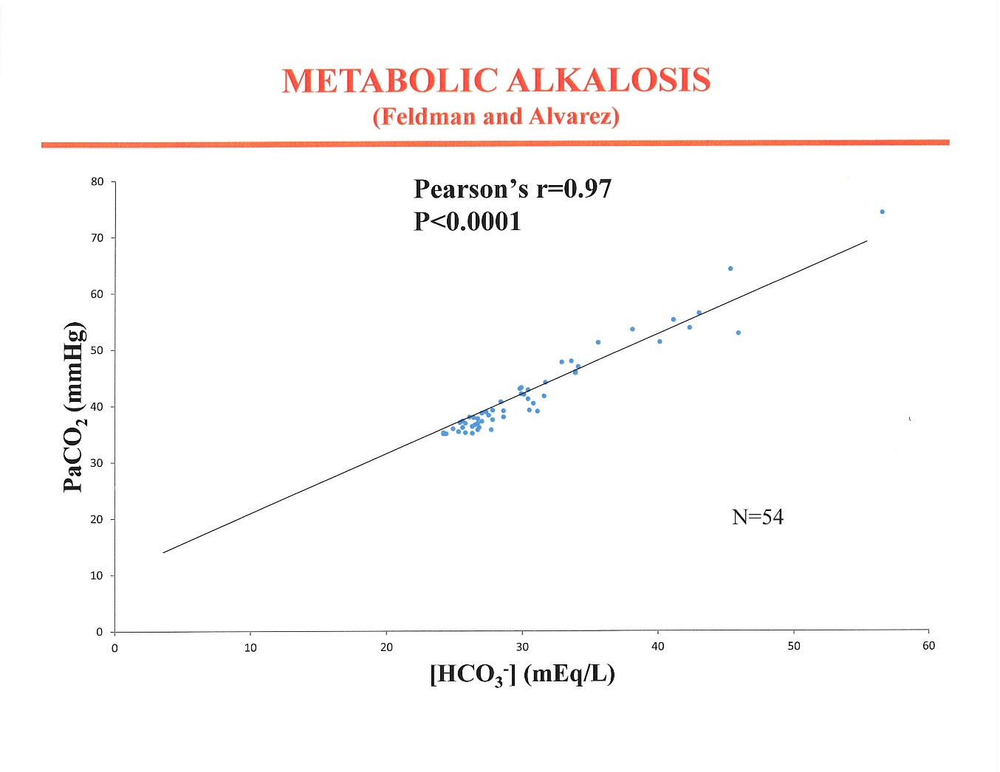

Slide 19
Correlations: Spearman’s rank order test
A nonparametric test similar to the Spearman test for parametric data.

Slide 21
Causal versus Confounding Association
There is a strong correlation between monthly ice cream consumption and monthly drowning rates in the USA
Does eating ice cream cause drowning?
Does drowning lead to ice cream eating?
Or is there a confounding factor?

Slide 22
IV. Odds Ratios and Risk Ratios For Categorical Outcomes
PE vs, no PE; Healed vs. not Healed; Remission vs. no Remission
A new treatment for active ulcerative colitis is compared to a standard treatment in 245 patients. (See Statistics 101, for Fisher exact test and chi square test)
120 patients are randomized to the new treatment and 125 to the standard treatment, each for 8 weeks.
90/120 given the new treatment group went into REMISSION at 8 weeks (75%).
75/125 given the standard treatment went into REMISSION at 8 weeks (60%).
What is the odds ratio for a REMISSION with the new treatment?

Slide 23
Odds ratio (OR) of remission with the new Rx for UC
REMISSION
NO REMISSION
New Rx 90 (a) 30 (b) 2 X 2 Table
Standard Rx 75 (c) 50 (d)
odds ratio = a/c ÷ b/d= 90/75 ÷ 30/50
odds ratio = ad/bc = 90⋅50/30⋅75
odds ratio = 4,500/ 2,250= 2.0
Calculate the 95% CI of this 2.0 odds ratio to determine whether the lower boundaryary of the Confidence Interval (CI) overlaps 1 or not.

Slide 24
Ulcerative Colitis Study: 95% CI of the OR
First, we must calculate the Ln of the 95% CI (z=1.96)
Ln 95% CI = Ln OR ± 1.96√ (1/a)+(1/b)+(1/c)+(1/d)
Ln 95% CI = Ln 2.0 ± 1.96√ (1/90)+(1/30)+(1/75)+(1/50)
Ln 2.00= 0.693. Thus, Ln 95% CI= 0.693 ± 0.546, or 0.147, 1.239.
To find the actual 95% CI, we must find the antiLn of 0.147 and of 1.239.
AntiLn x is the number that results when you raise e to the x power.
antiLn 0.147 = e^{.147} =1.16; and the antiLn 1.239 = e^{1.239} =3.45.
∴ 95% CI =1.16, 3.45 (lower and upper boundaryaries of the 95% CI) and the odds ratio for a remission with the new treatment is 2.00 (1.16, 3.45).
As the lower boundaryary of the OR is 1.16 (> 1), the difference is unlikely due to chance and is significant at the 0.05 level. The OR could be as high as 3.45.

Slide 25
Risk ratio (RR) of a remission with the new Rx for UC
REMISSION
NO REMISSION
New Rx 90 (a) 30 (b)
Standard Rx 75 (c) 50 (d)
risk ratio = (a/a+b)) ÷ (c/c+d))
risk ratio = (90/120) ÷ (75/125)= 1.25
We can calculate the 95% CI of this risk ratio:
Ln CI= Ln (RR) ± 1.96√[(b/a)÷(a+b)] + [(d/c)÷(c+d)]
    = 0.2231 ± 0.1764, or 0.0467, 0.3995
    Antilogs of lower and upper limits of ln CI: 1.05, 1.49
∴ RR is 1.25 with a 95% CI of 1.05,1.49 (note: RR≠OR)

Slide 26
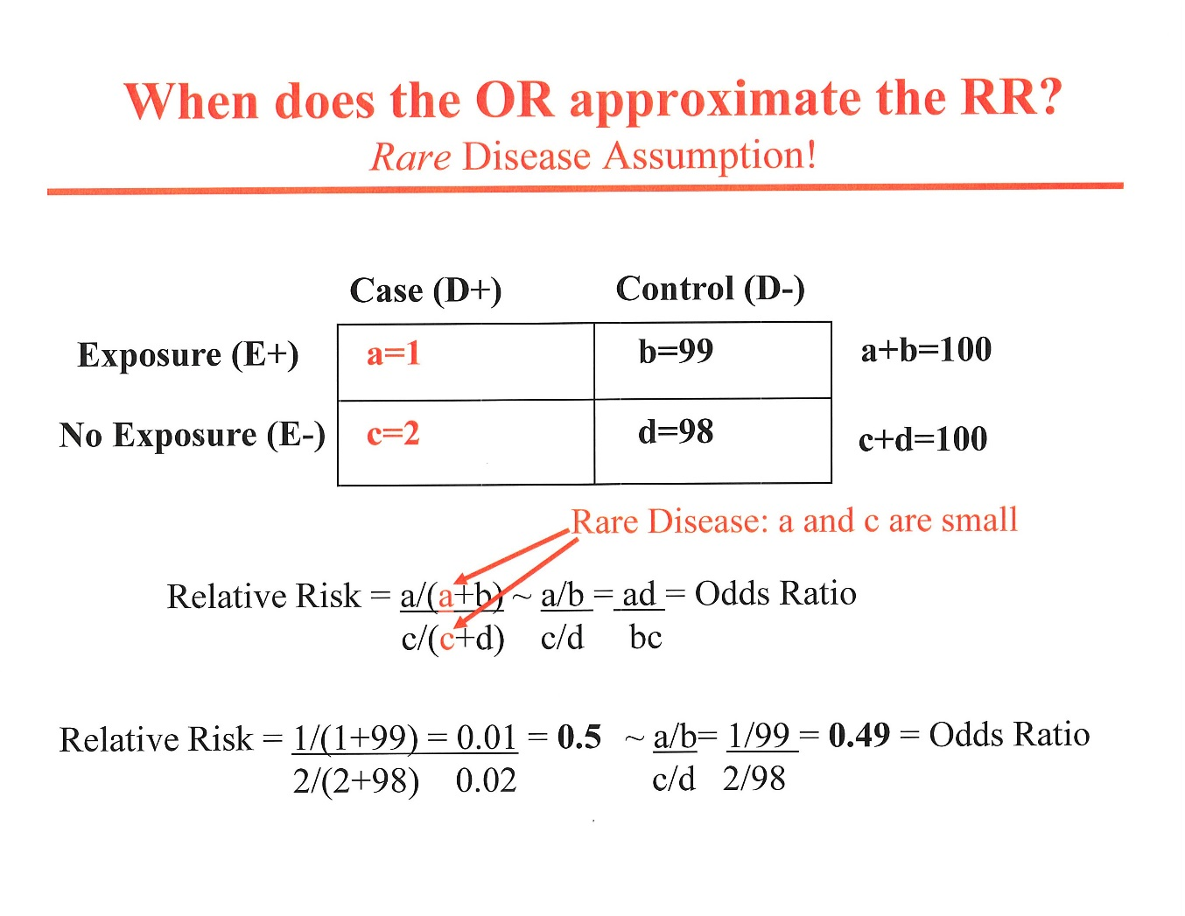

Slide 27
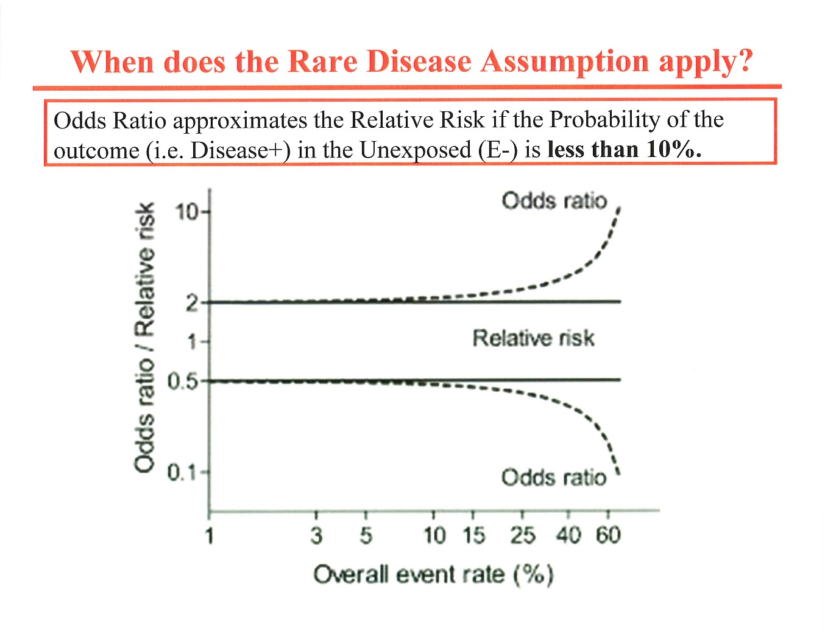

Slide 28
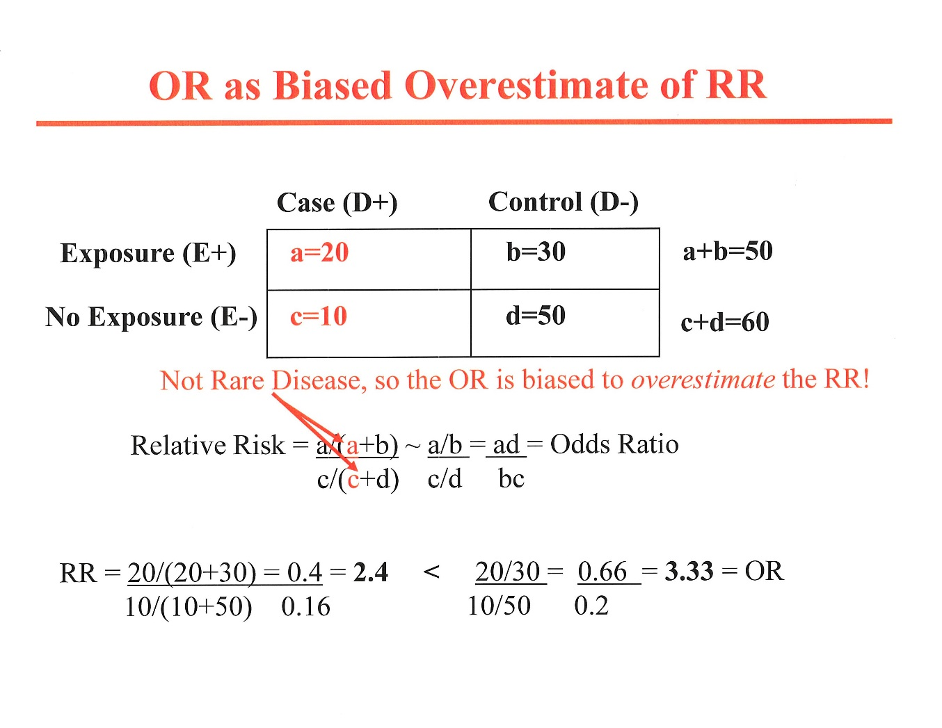

Slide 29
Note:
OR and RR are determined for a single point in time (e.g., 8 weeks).
To examine the ENTIRE time course of an effect of a treatment, use Kaplan-Meier method or the Cox model to calculate a hazard ratio
Survival Analysis, Statistics 103

Slide 30
V. Non-inferiority (NI) trial
Compares two treatments, an active control and a new treatment, with the purpose of testing when the new treatment is not materially inferior to the active control treatment.
  These studies are not testing equivalence
Performed mainly for ethical reasons, where it would be unethical to use a placebo control and test for superiority.

Slide 31
Placebo-controlled superiority trial
FDA Document November, 2016:
  A classic (placebo-controlled) superiority study, if successful in showing a difference, is entirely interpretable without further assumptions (other than lack of bias)⎯ that is, the result speaks for itself and requires no extra-study information.

Slide 32
Null and alternate hypotheses in a placebo-controlled superiority trial
GOAL: To show that the test drug (T) is superior to the response to a placebo (P)
H₀: T≤P; T-P≤0, where H₀ is the null hypothesis and T-P is treatment effect (T= treatment and P=placebo)
H_{a}: T>P; T-P>0, where is H_{a} is the alternate hypothesis
Treatment effect, T-P, is the point estimate and is expressed with its 95% Confidence Interval (CI)
T-P is often referred to as the delta (Δ). This Δ has a 95% CI.

Slide 33
3 possible results of placebo-controlled superiority trial
1. Point estimate of T-P is 2; 95% CI lower boundary is 1. CONCLUSION: Drug is effective and has an effect of at least 1.
2. Point estimate of T-P is 2; 95% CI lower boundary is <0. CONCLUSION: Drug is not shown to be effective.
3. Point estimate of effect is 0; 95% CI lower boundary is well below 0. CONCLUSION: Drug is not shown to be effective.

Slide 34
Non-inferiority (NI) trial vs. placebo-controlled trial.
A variant on 95% CIs.
FDA Document November, 2016:
  A classic (placebo-controlled) superiority study, if successful in showing a difference, is entirely interpretable without further assumptions (other than lack of bias)⎯ that is, the result speaks for itself and requires no extra-study information.
21 CFR 314.126(a)(2)(iv) since 1985 has stated:
  If the intent of the trial is to show similarity of the test and control drugs, the report of the study should assess the ability of the study to have detected a difference between treatments. Similarity of test drug and active control can mean either that both drugs were effective or that neither was effective. The analysis of the study should explain why the drugs should be considered effective in the study, for example, by reference to results in previous placebo-controlled studies of the active control drug.

Slide 35
Null and alternate hypotheses in a noninferiority (NI) trial
GOAL: To show that the effect of the test drug (T) is not inferior to the effect of the active control (C) by a specified amount called the noninferiority margin (M). M is specified in advance (a priori).
H₀: C-T≥M (T is inferior to control (C) by M or more)
H_{a}: C-T<M (T is inferior to the control (C) by less than M)
Note: Whether we accept H_{o} or H_{a} depends heavily on the selection of M.

Slide 36
6 possible results of NI trial (with M=2)
1. Point estimate of C-T is 0; upper boundary of 95% CI for C-T is 1, well below M_{I}. CONCLUSION: NI is demonstrated.
2. Point estimate of C-T favors C; upper boundary of 95% CI for C-T is >2, above M_{I}. CONCLUSION: NI is not demonstrated
3. Point estimate of C-T is 0; upper boundary of 95% CI for C-T is > 2. CONCLUSION: NI is not demonstrated.
4. Point estimate favors T. CONCLUSION: NI is demonstrated, but superiority is not demonstrated
5. Point estimate favors T. CONCLUSION: superiority and NI are demonstrated.
6. Point estimate of C-T is 1; upper boundary of 95% CI for C-T is < M_{I}, demonstrating NI but at the same time the 95% CI for C-T is > 0. CONCLUSION: T is actually inferior to C, even while meeting the NI standard.

Slide 37
Two Treatments (CABG vs. PCI) for Left Main CAD
“The NIM (M) of 4.2% was agreed on by the study leadership of cardiac surgeons and interventional cardiologists as consistent with an interpretation of equipoise between the two treatments, given the lower periprocedural morbidity associated with PCI.”
  Equipoise: balance of forces or interests
Stone GW et al. NEJM 2016: 375: 2223-35

Slide 38
Using hazard ratios rather than the Δ (NIM, or M)
EINSTEIN-PE NI Trial (NEJM 2012; 366: 1287-97).
Investigators compared rivaroxaban (Xarelto) vs. standard vitamin K antagonist in 4,832 patients with PE
Powering: The investigators calculated that 88 recurrent, symptomatic VTE events would provide 90% power (1-β) to show that rivaroxaban is non-inferior to standard VKA therapy using an upper boundaryary of the 95% CI of 2.00 for the hazard ratio, with a 2-sided α of 0.05.
Results (efficacy): 94 events occurred. Rivaroxaban pts had 50 VTE events (2.07 %) vs. 44 events (1.82%) with standard VKA therapy. (12% more events.) HR 1.12 (95% CI, 0.75-1.68). As 1.68<2.00, NI was concluded.
  Actual difference (Δ)in efficacy: 0.24% in favor of standard therapy (95% CI, -0.58% to 1.07%)
Results (safety): Major or clinically relevant non-major bleeding occurred in 10.3% of rivaroxaban patients and in 11.4% of standard therapy patients. (10% less bleeds.) HR, 0.9 (95% CI, 0.76-1.07).
  Actual difference (Δ) in safety: 1.06% in favor of rivaroxaban (95% CI, -0.72% to 2.85%)
Conclusions: A fixed-dose regimen of rivaroxaban alone was noninferior to standard therapy for the initial and long-term treatment of pulmonary embolism and had a potentially improved benefit–risk profile.

Slide 40
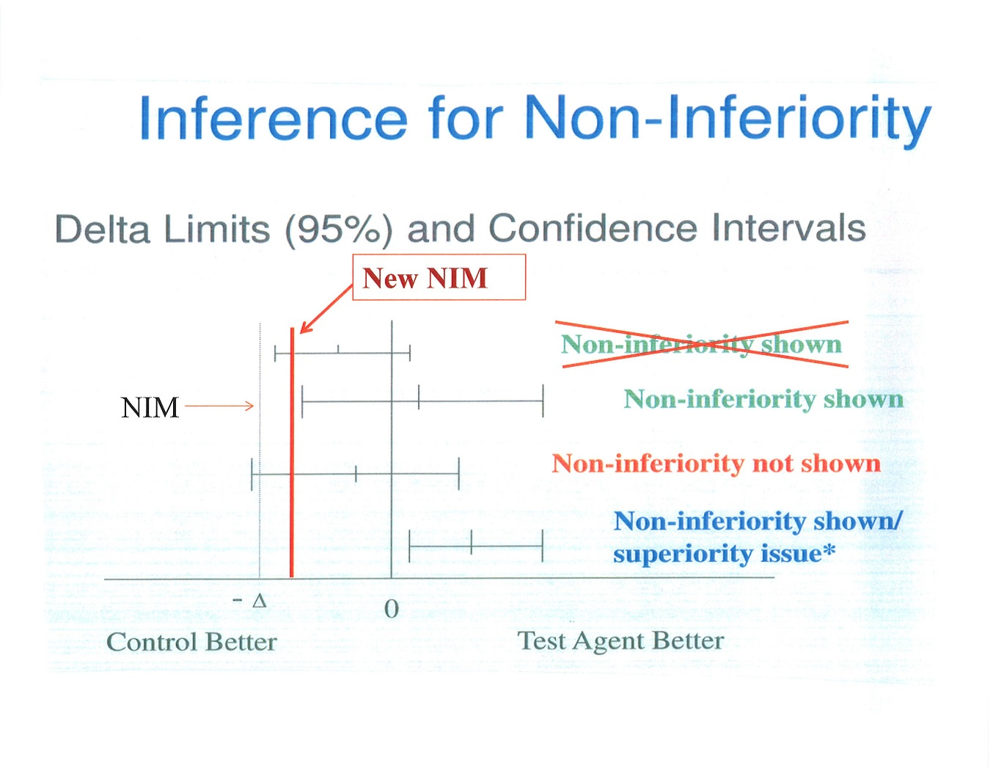

Slide 41
95% CI of an odds ratio
  e≅ 2.71828182846… (Euler’s number), an irrational or transcendental number
  Lnx = the power by which you must raise e to in order to obtain x
    ln 7.3891 = ln e² = 2; lne =1 and ln 1=0
  If an odds ratio, ad/bc, =1 (i.e., no increased or decreased odds), then Ln (ad/bc)=Ln1=0
  If ad/bc>1 (increased odds of outcome), then Ln (ad/bc)>0 (i.e., odds ratio is a positive number); e.g., for an odds ratio of 2, Ln2= 0.6931
  If ad/bc <1 (reduced odds of outcome), Ln ad/bc<0 (i.e., odds ratio is a negative number); Ln0.5= -0.6931

